Slide 1
MICRO CREDIT DEFAULTER PROJECT
SUBMITTED BY
GIRIJA CHANDRA MOHAN

Slide 2
Introduction
A Microfinance Institution (MFI) is an organization that offers financial services to low income populations. MFS becomes very useful when targeting especially the unbanked poor families living in remote areas with not much sources of income. The Microfinance services (MFS) provided by MFI are Group Loans, Agricultural Loans, Individual Business Loans and so on. Many microfinance institutions (MFI), experts and donors are supporting the idea of using mobile financial services (MFS) which they feel are more convenient and efficient, and cost saving, than the traditional high-touch model used since long for the purpose of delivering microfinance services. Though, the MFI industry is primarily focusing on low income families and are very useful in such areas, the implementation of MFS has been uneven with both significant challenges and successes.

Slide 3
Today, microfinance is widely accepted as a poverty-reduction tool, representing $70 billion in outstanding loans and a global outreach of 200 million clients. We are working with one such client that is in Telecom Industry. They are a fixed wireless telecommunications network provider. They have launched various products and have developed its business and organization based on the budget operator model, offering better products at Lower Prices to all value conscious customers through a strategy of disruptive innovation that focuses on the subscriber. They understand the importance of communication and how it affects a person’s life, thus, focusing on providing their services and products to low income families and poor customers that can help them in the need of hour. They are collaborating with an MFI to provide micro-credit on mobile balances to be paid back in 5 days. The Consumer is believed to be defaulter if he deviates from the path of paying back the loaned amount within the time duration of 5 days. For the loan amount of 5 (in Indonesian Rupiah), payback amount should be 6 (in Indonesian Rupiah), while, for the loan amount of 10 (in Indonesian Rupiah), the payback amount should be 12 (in Indonesian Rupiah).

Slide 4
Points to remember
There are no null values in the dataset.
There may be some customers with no loan history.
The dataset is imbalanced. Label ‘1’ has approximately 87.5 percent records, while, label ‘0’ has approximately 12.5 percent records.
For some features, there may be values which might not be realistic. You may have to observe them and treat them with a suitable explanation.
You might come across outliers in some features which you need to handle as per your understanding. Keep in mind that data is expensive and we cannot lose more than 7-8 percent of the total data.

Slide 5
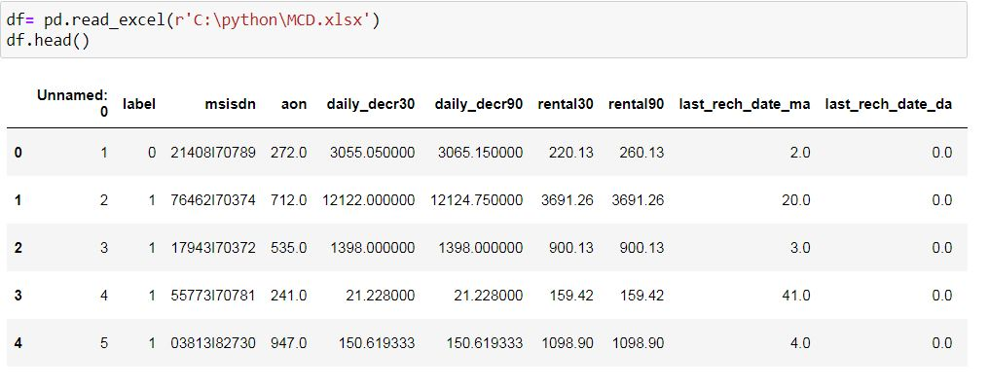
DATA SOURCES AND THEIR FORMATS

Slide 6
Exploratory Data Analysis
First we have imported the necessary libraries and loaded the entire dataset in our Jupyter Notebook and renamed the project file from untitled.
Then I checked the shape of our dataset and found that we have a total of 2,09,593 rows and 37 different columns.
We don’t have any null values or missing values present in our dataset.
There was only one duplicate row/record in our dataset and I removed it from our dataset.
By checking the data types I came to know that our data set consists of columns have float, integer and object data type values.

Slide 7
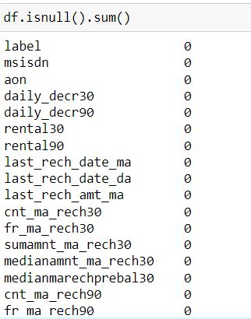
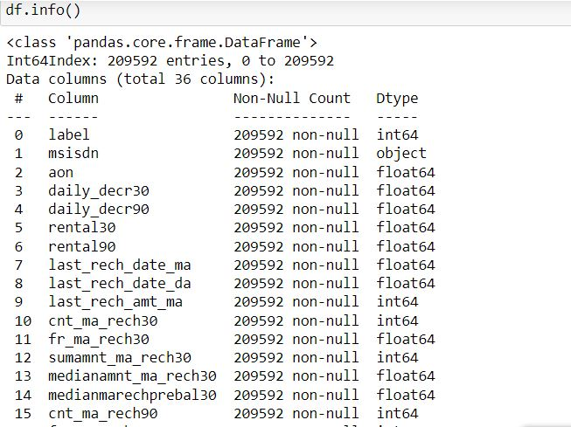
DATA PRE-PROCESSING
Handling missing data using fillna and checking the datatypes

Slide 8
MODEL/S DEVELOPMENT AND EVALUATION
Various models used for training are:
LogisticRegression()
GuassianNB()
DecisionTreeclassifier()
RandomForestClassifier()
KNN()
Run and Evaluate selected models
We have used a total of 5 Regression Models after choosing the random state amongst 1-100 number. Then it is checked for best fold for CV using the following codes

Slide 9
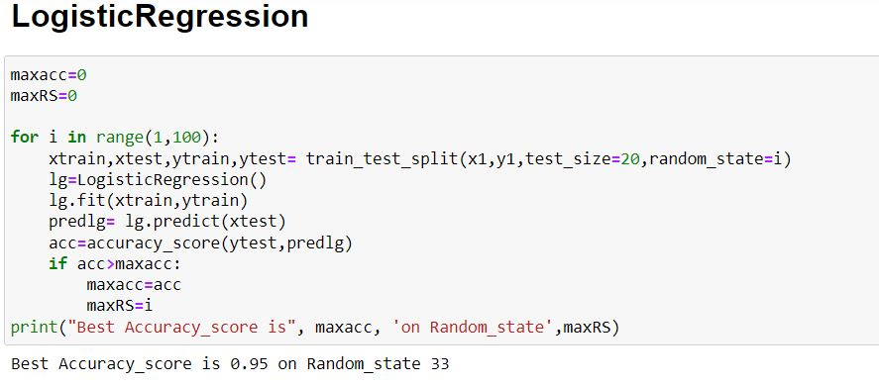

Slide 10
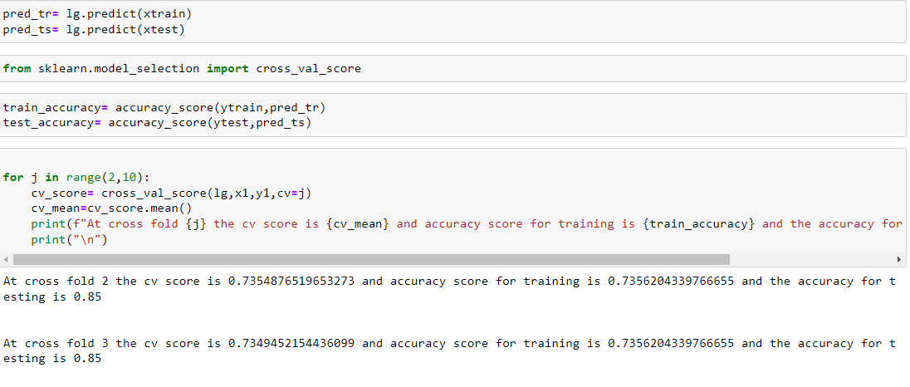

Slide 11
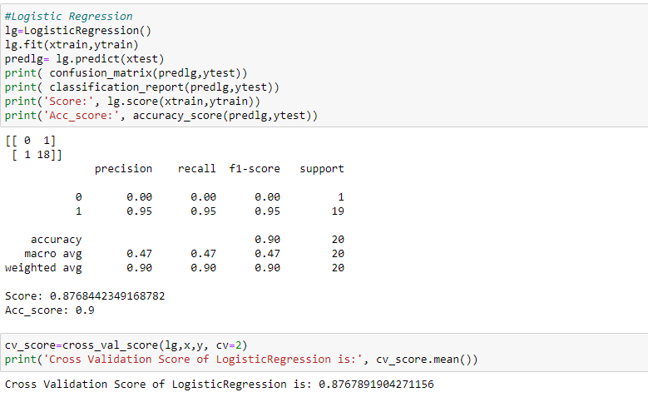
Logistic Regression

Slide 12
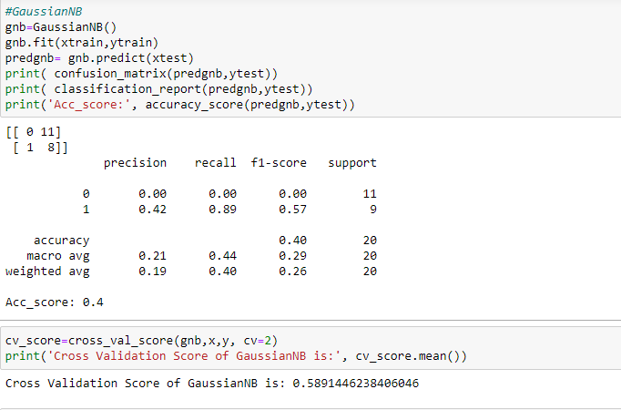
GuassianNB

Slide 13
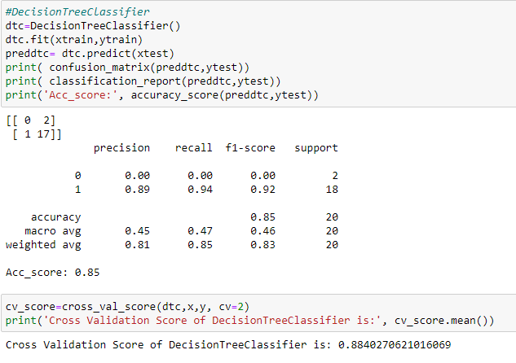
Decision Tree Classifier

Slide 14
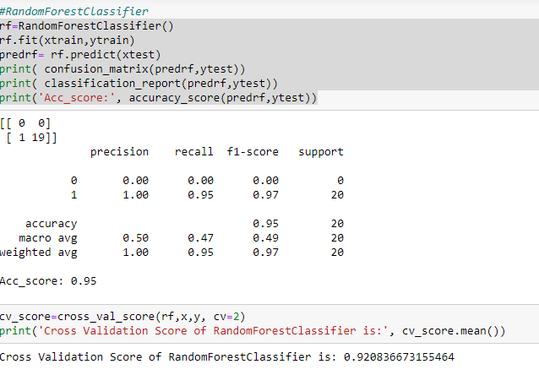
Random Forest Classifier

Slide 15
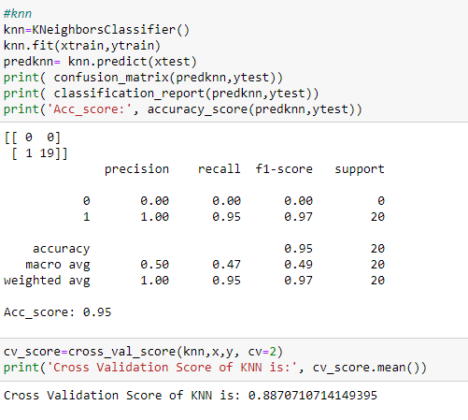
KNN

Slide 16
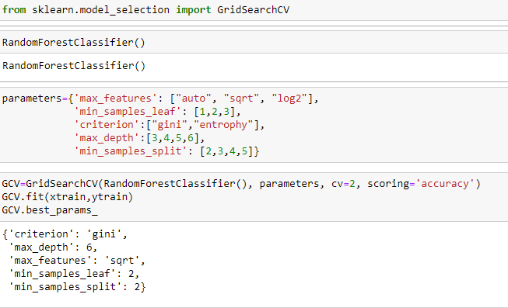
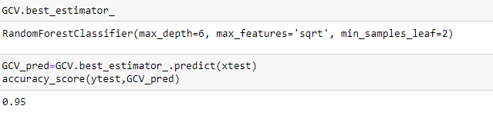
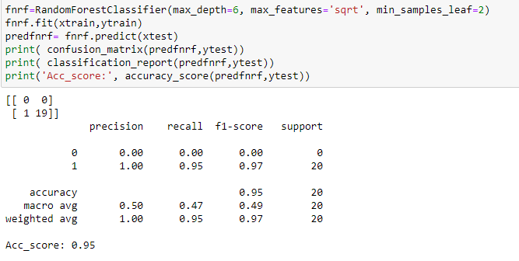
HyperParameter Tuning

Slide 17
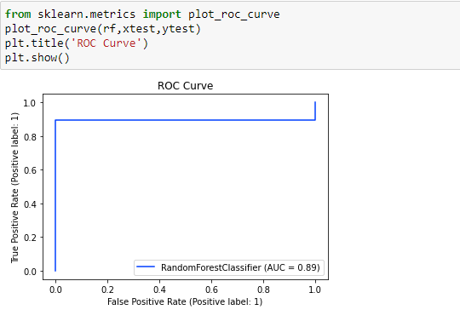
After applying Hyperparameter Tuning, we can see that RandomForestClassifier Algorithm is performing well as the scores are improved Now, we will finalize RandomForestClassifier algorithm model as the final model.
Final Model

Slide 18
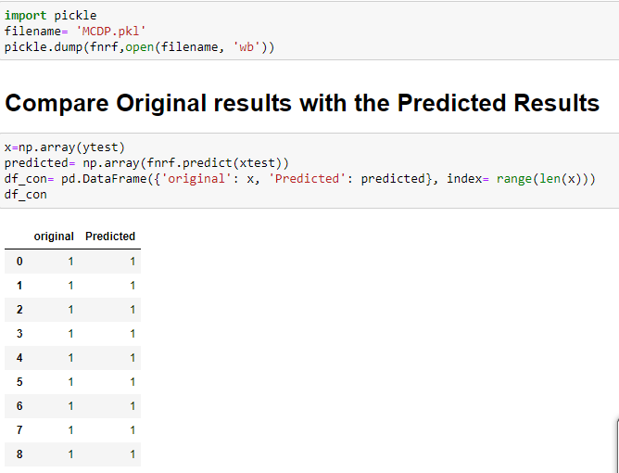
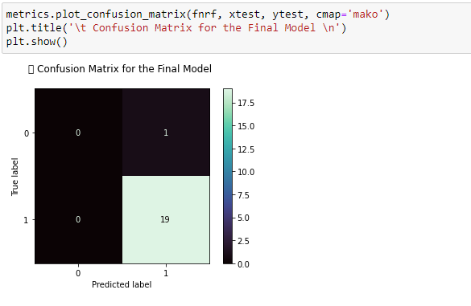

Slide 19
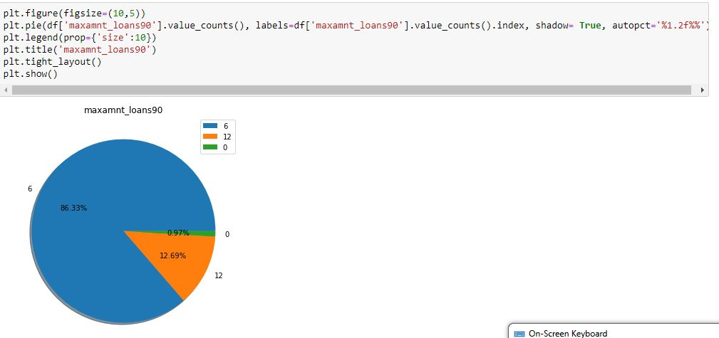
DATA VISUALIZATION

Slide 20
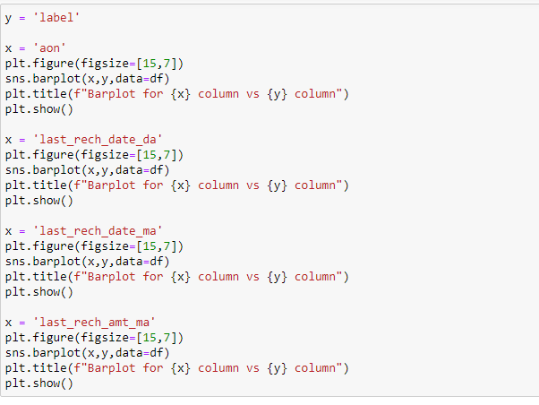
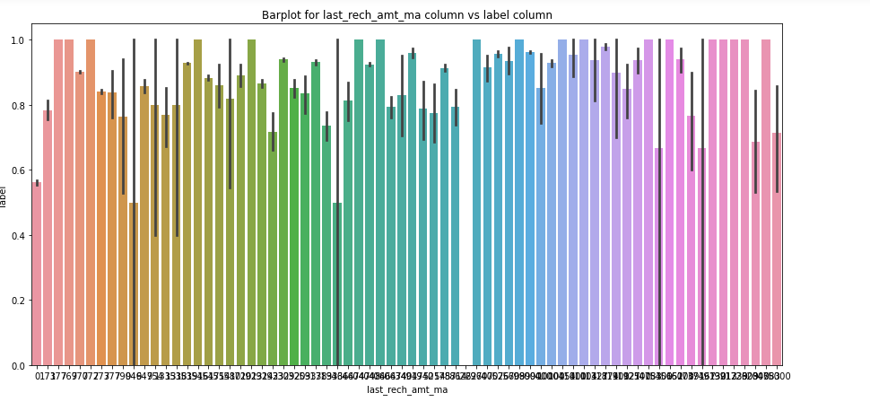

Slide 21
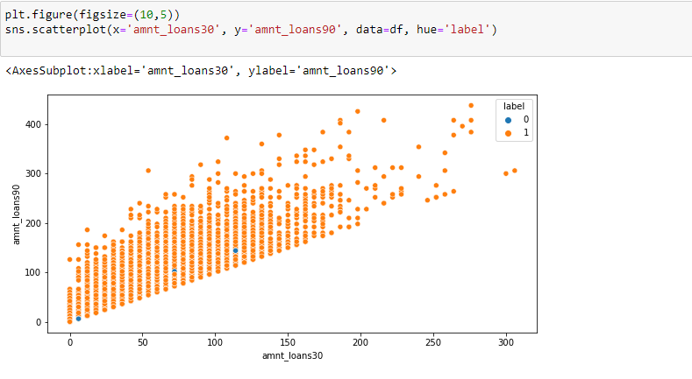

Slide 22
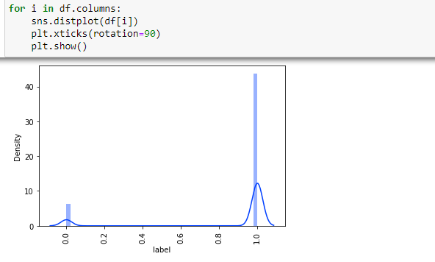

Slide 23
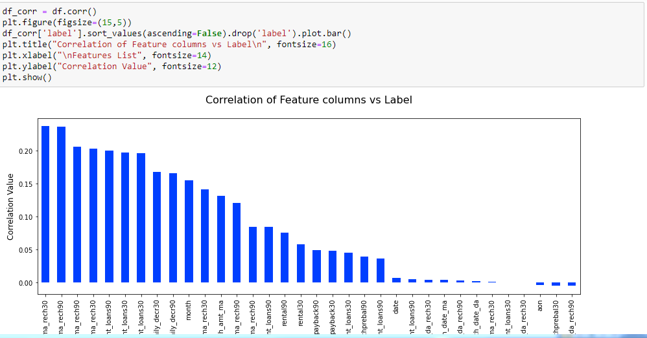
Correlation of columns with the Label

Slide 24
CONCLUSION
From the final model we can find if a person will return money or not and should an MFI provide a loan to that person or not judging from the various features taken into consideration.
Learning Outcomes of the Study in respect of Data Science
We built multiple classification models and did not rely on one single model for getting better accuracy and using cross validation comparison and ensured that the model does not fall into overfitting and underfitting issues. The best one is selected and performed hyper parameter tuning on it to enhance the scores

Slide 25
Limitations of this work and Scope for Future Work
Limitation is it will only work for this particular use case and will need to be modified if tried to be utilized on a different scenario but on a similar scale. Scope is that we can use it in companies to find whether we should provide loan to a person or not and we can also make prediction about a person buying an expensive service on the basis of their personal details that we have in this dataset like number of times data account got recharged in last 30 days and daily amount spent from main account, averaged over last 30 days (in Indonesian Rupiah) so even a marketing company can also use this.

Slide 26
Thank You

